Slide 1
CAPSTONE PRESENTATION
SENTIMENT ANALYSIS
“Neural Network - Deep Learning”
Collaborator: Luka Anicin
Data Scientist: Ruslan S.

Slide 2
OBJECTIVES
Problem: predict the company’s image based on users’ reviews
Context: the "face" of the company plays a profound role in its success. It's reflected in its reputation, trustworthiness, accountability, and other important aspects that drives the business’ success

Slide 3
METRICS
CONSTRAINTS
STAKEHOLDERS
Model accuracy: 65-89%
Delivery: October 2021
Data
Time
Limited stuff
Business with twitter account

Slide 4
PROBLEM IDENTIFICATION
Approach:
Supervised Classification
(2 classes)
Learning algorithm:
CNN Sequential
(5 hidden layers)

Slide 5
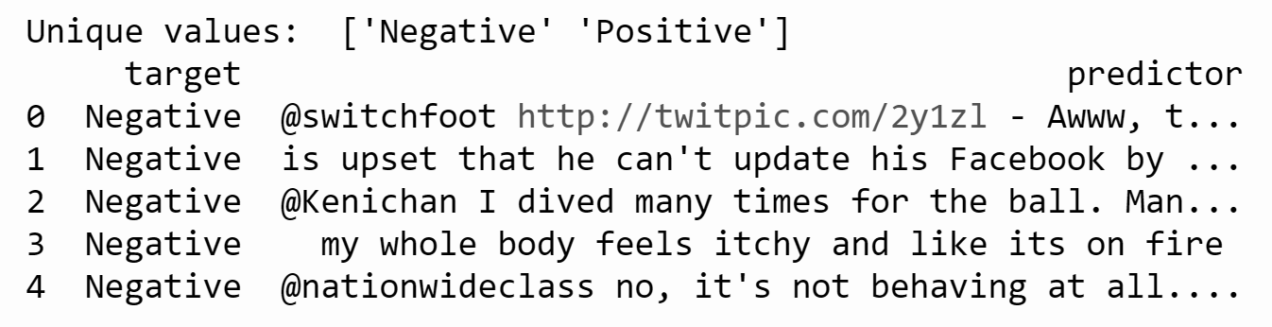
DATA DESCRIPTION
Column names: “target” and “predictor”
Dimension: (1,583,691 by 2)
Date/time range: 04/06/2009-06/16/2009

Slide 6
WRANGLING STEPS
Dropping irrelevant columns
Id, date, query, user_name
Converting target class into binary with type “int”
Values 0 (negative) and 1 (positive)
Dealing with duplicates
Removing noise in text (using regular expression)
Dealing with stop words (using internal library)
Applying stemming
Splitting into training and testing datasets
Tokenization

Slide 7
KEY TAKEAWAYS
Working with text (in our case with tweets) gets complicated because of dealing with:
Grammar mistakes
The use of short (simplified) words
Combination of different types of characters
Emojis
And so on...

Slide 8
EDA
(EXPLORATORY
DATA ANALYSIS)

Slide 9
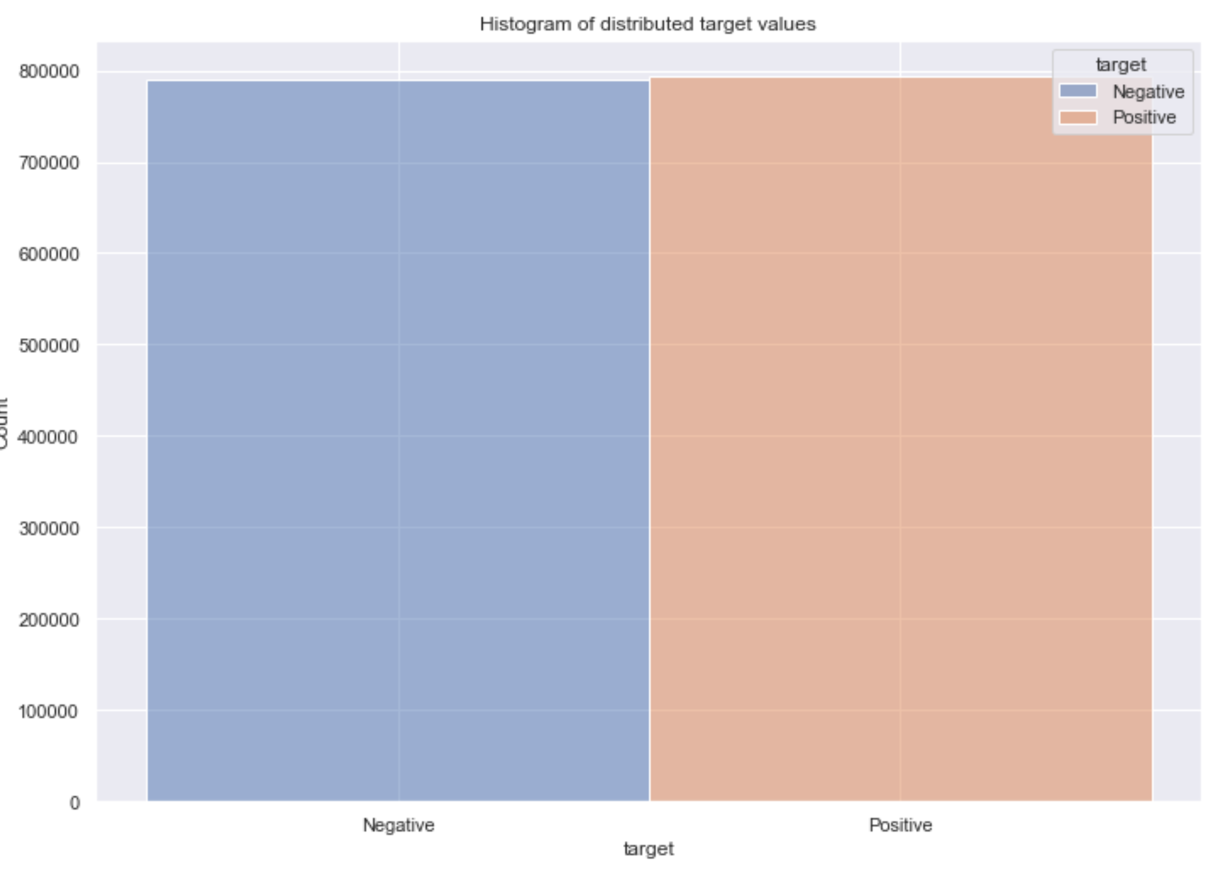
Ratio of classes

Slide 10
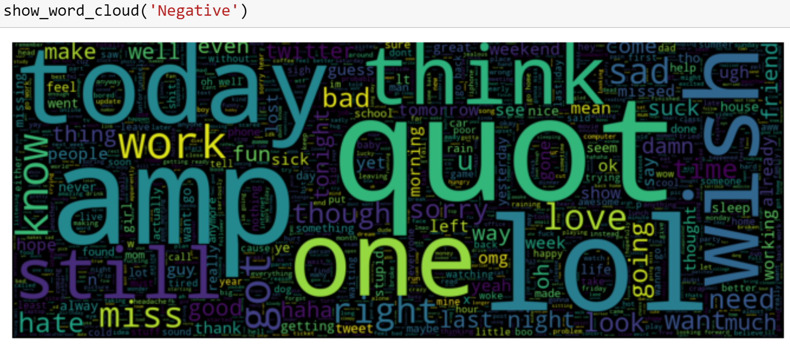
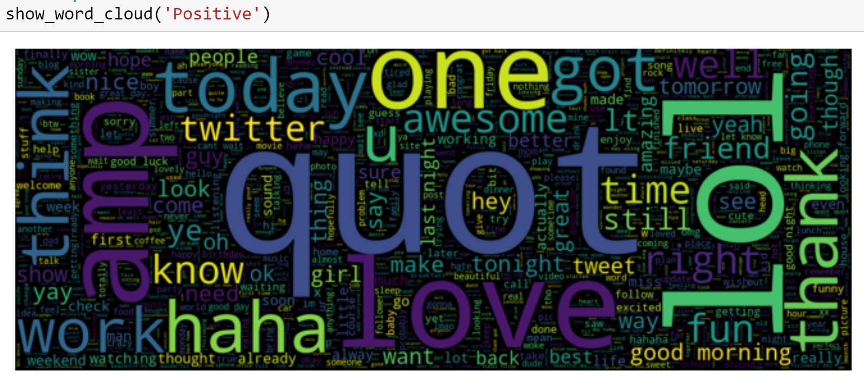
Most common negative and positive words

Slide 11
MODELING

Slide 12
LEARNING ALGORITHM
Model type:
Sequential
Architecture:
CNN (convolutional neural network 1 dimension)
Layers:
5 hidden layers: Embedding, SpetialDropout1D, LSTM, and 2 Dense layers

Slide 13
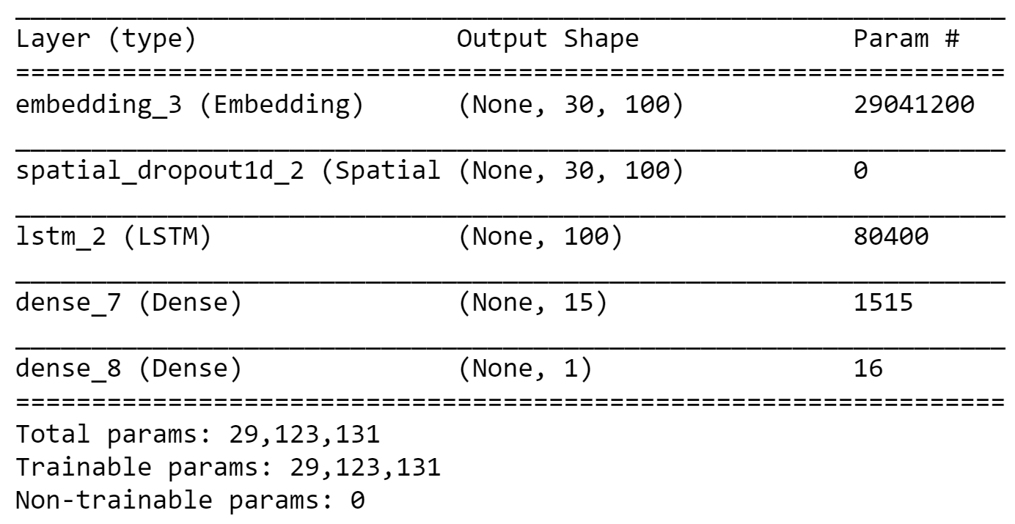
ALGORITHM SUMMARY

Slide 14
FACTORS TOWARD
CHOSEN MODEL
Size of data set
Accuracy

Slide 15
PERFORMANCE
RESULTS

Slide 16
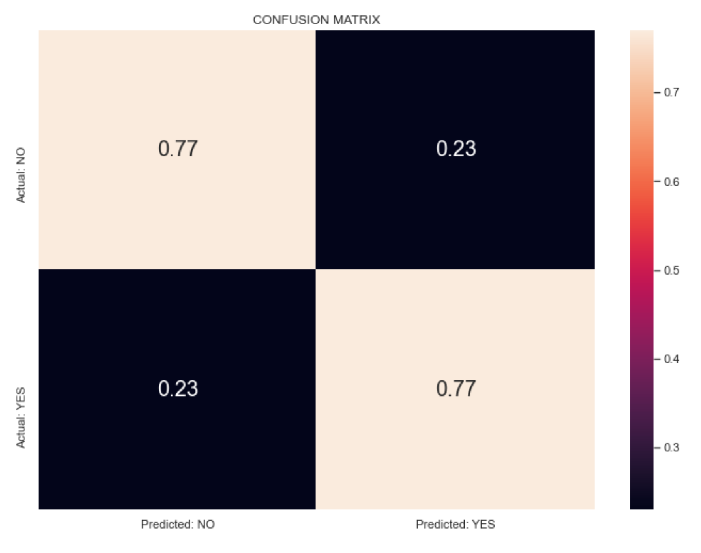
CONFUSION MATRIX

Slide 17
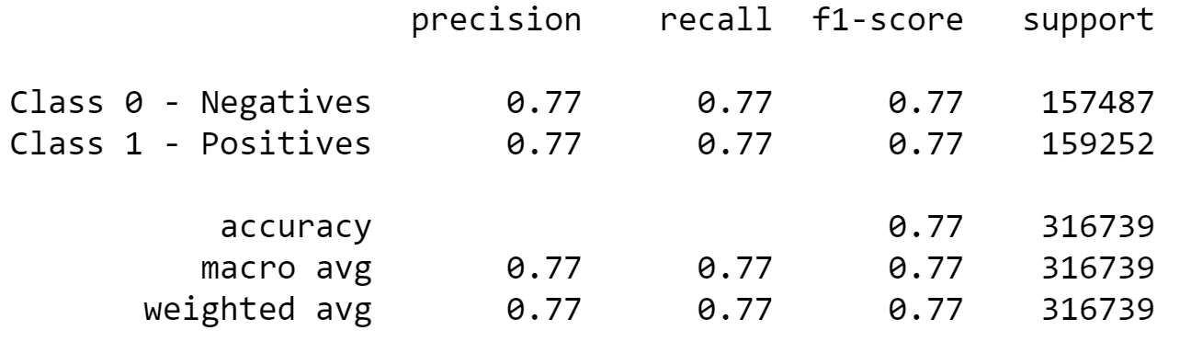
PREDICTION SCORE

Slide 18
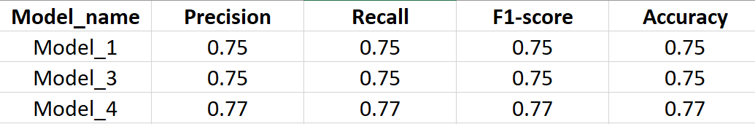
RECOMMENDATION
Slow to train
At risk of overfitting

Slide 19
FUTURE WORK
Increase size
Use most recent data
Play with hyper-tuning
Reconstruct architecture of the model
Use more libraries to deal with text (to correct grammar mistakes or convert emojis into words and so on)

Slide 20
End of slide show

